Slide 1
Latent Heat
Year 11 Physics

Slide 2
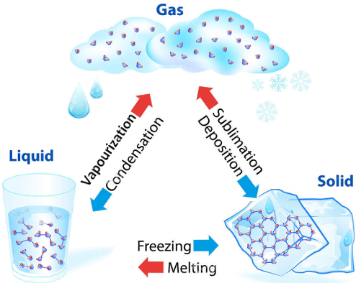
Change of state
Changes of state are reversible changes in matter.
During these processes, matter’s chemical
properties and molecular composition
do not change.

Slide 3
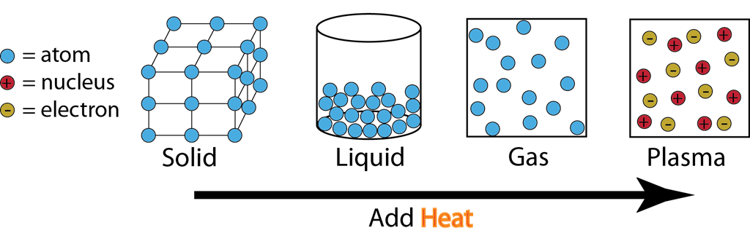
Change of state:
absorption or release of energy
When a solid is heated to its melting point, its particles gain energy and are able to partly overcome the forces of attraction between them.
They no longer stay in one fixed position, but they slip over one another as a liquid.

Slide 4
Change of state:
absorption or release of energy
When the liquid is heated to its boiling point, its particles gain enough energy to completely overpower the intermolecular
forces of attraction.
They begin to move around freely as a gas.

Slide 5
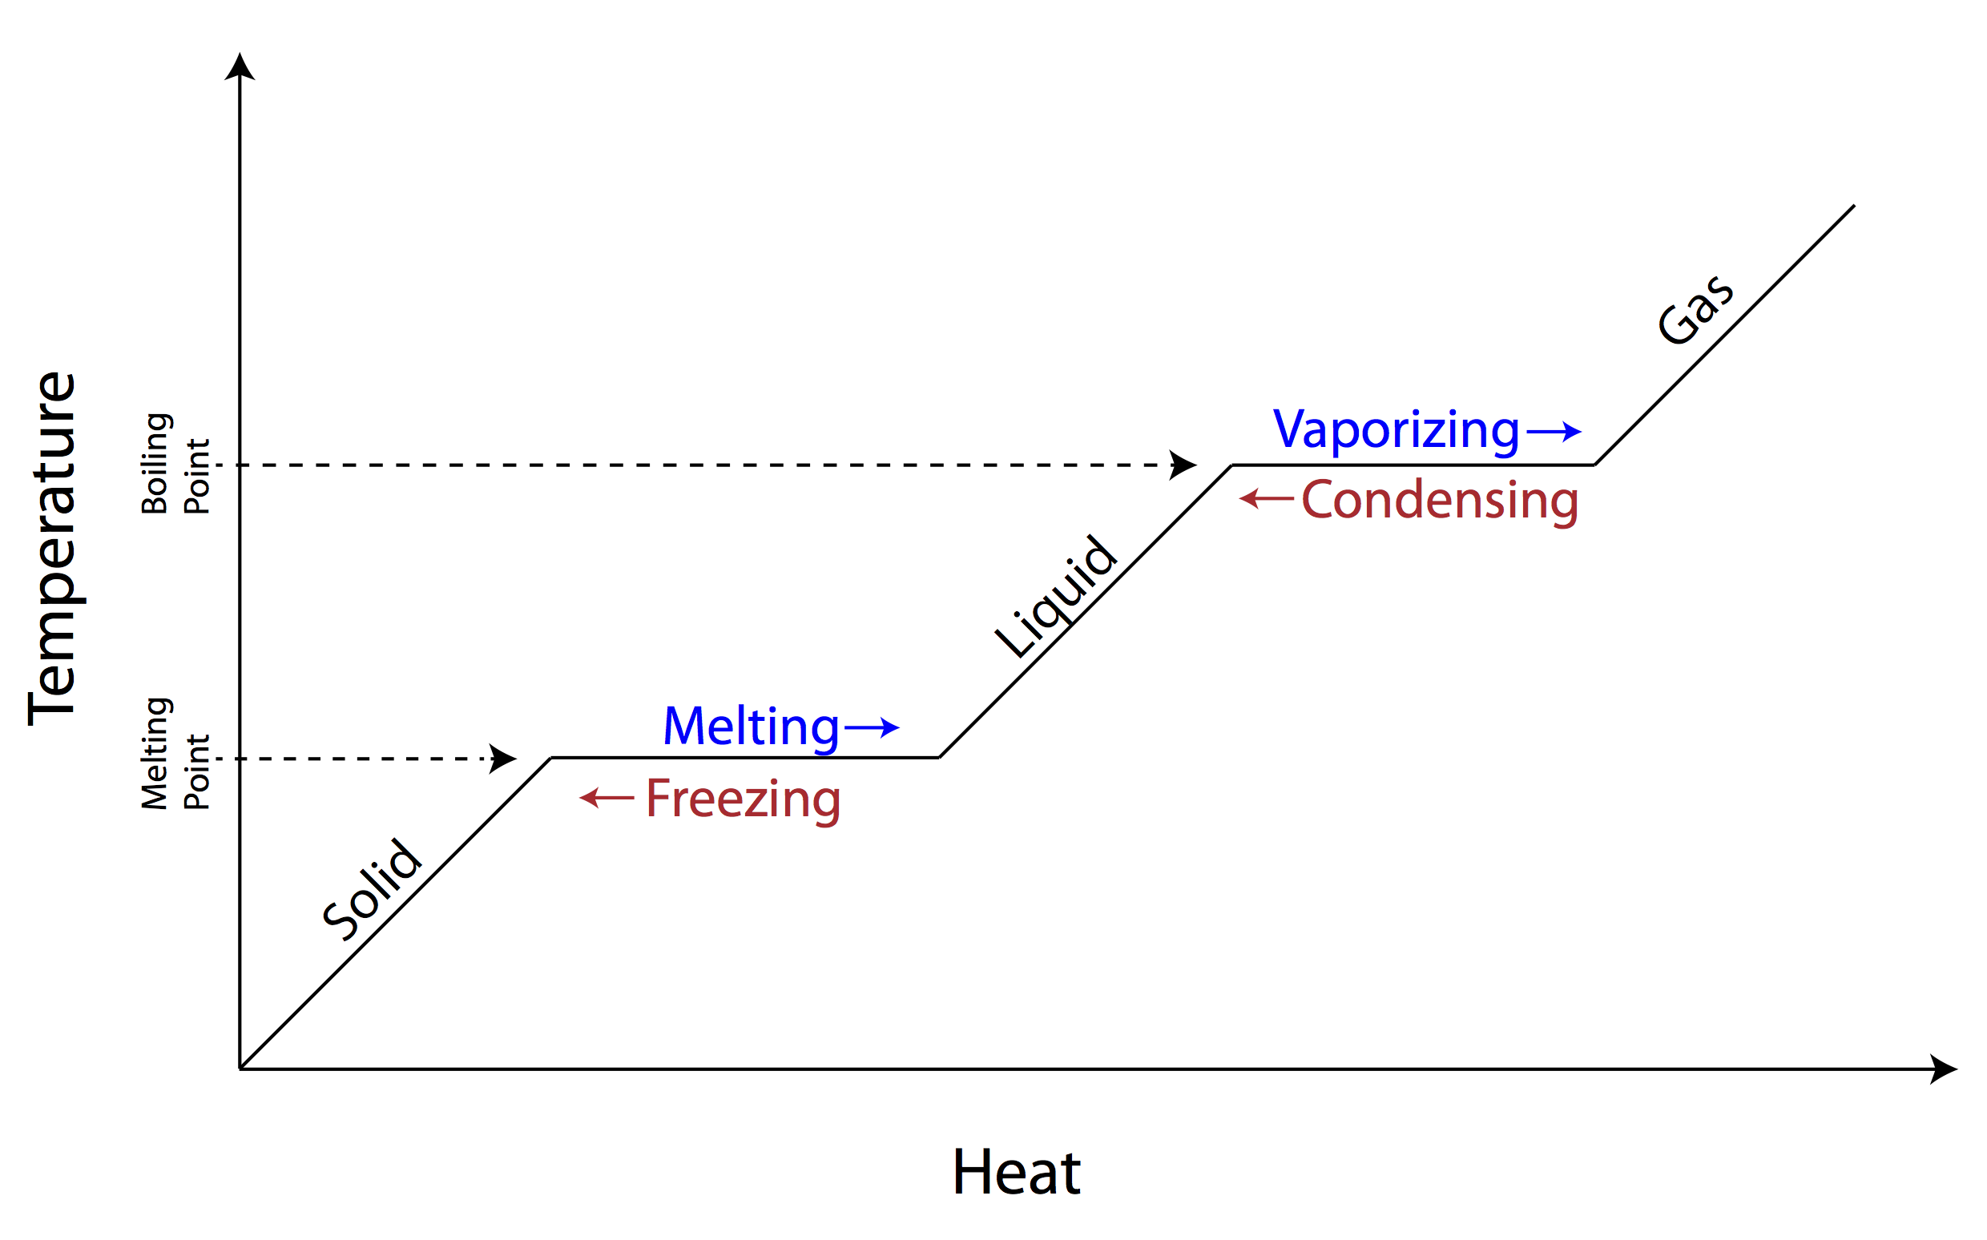
Change of State: absorption or release of energy
If heat is transferred to a substance, then the usual result is an increase in its temperature (i.e. an increase in the average kinetic energy of its
particles).
However, at certain temperatures, the
heat causes a change of state instead.

Slide 6
Latent Heat
During changes of state, a substance absorbs or releases heat, but its temperature remains the same.
Because of this, heat absorbed or released during a phase change is called latent heat. (Latent means hidden or concealed.)
Heat involved in changes between solid and liquid is called latent heat of fusion.
Heat involved in changes between liquid and gas is called latent heat of vaporisation.

Slide 7
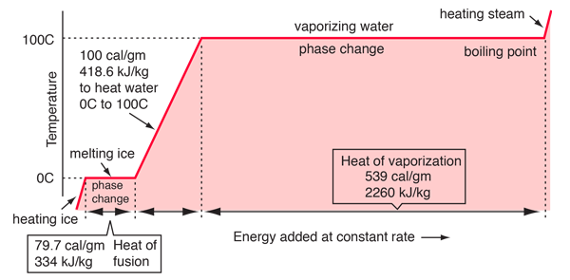
Latent heat

Slide 8
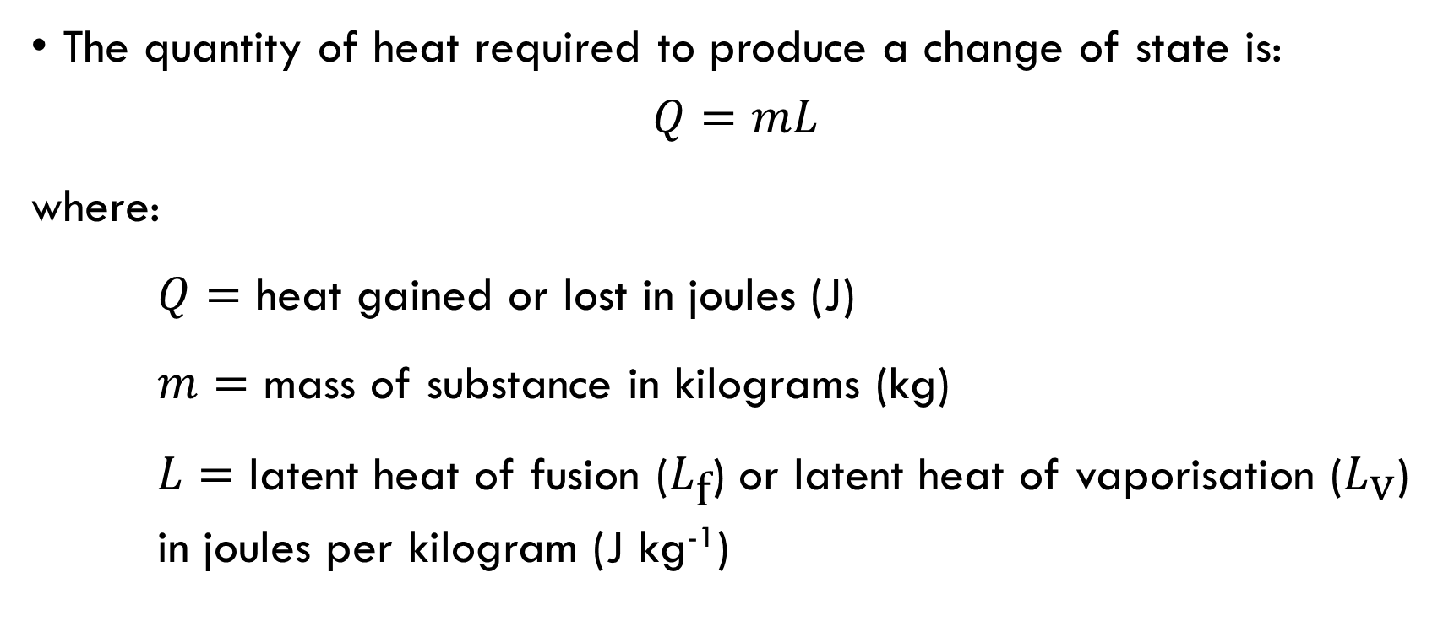
Latent Heat
The quantity of heat required to produce a change of state is:
$$Q=mL$$
where:
$Q=$ heat gained or lost in joules (J)
$m=$ mass of substance in kilograms (kg)
$L=$ latent heat of fusion ($L_{\text{f}}$) or latent heat of vaporisation ($L_{\text{v}}$) in joules per kilogram (J kg⁻¹)

Slide 9
Heating Curve
energy

Slide 10
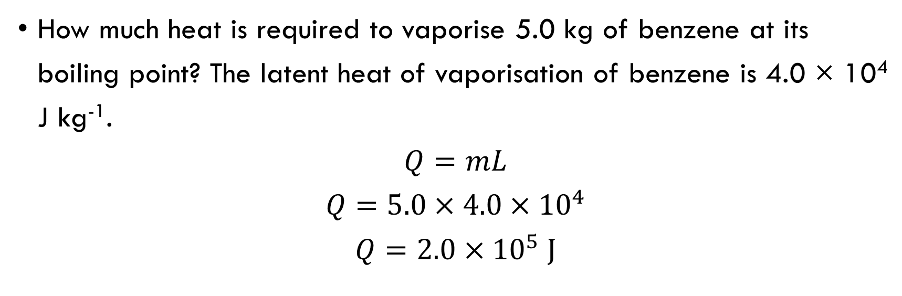
Example 1
How much heat is required to vaporise 5.0 kg of benzene at its boiling point? The latent heat of vaporisation of benzene is 4.0 × 10⁴ J kg⁻¹.
$$Q=mL$$
$$Q=5.0×4.0×{10}^{4}$$
$$Q=2.0×{10}^{5} \text{J}$$

Slide 11
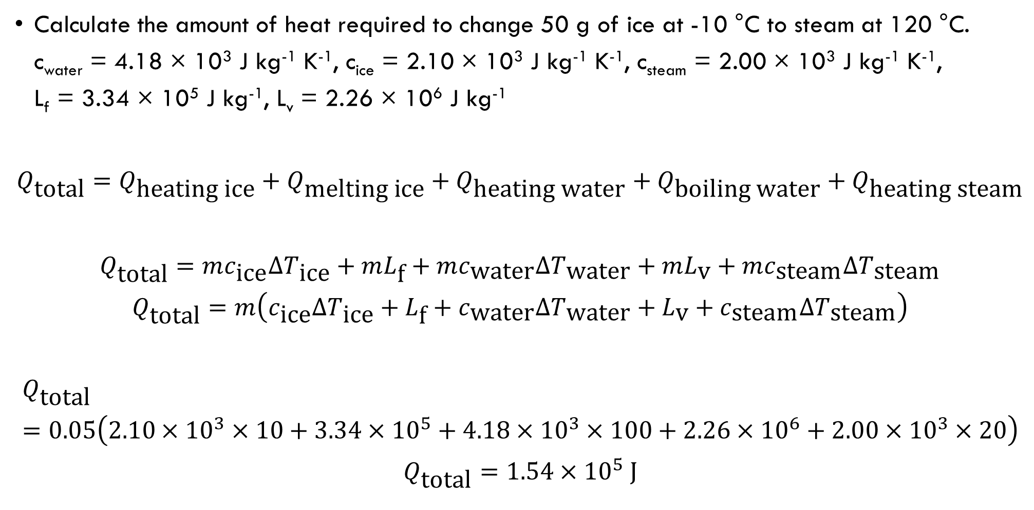
Example 2
Calculate the amount of heat required to change 50 g of ice at -10 °C to steam at 120 °C.
c_{water} = 4.18 × 10³ J kg⁻¹ K⁻¹, c_{ice} = 2.10 × 10³ J kg⁻¹ K⁻¹, c_{steam} = 2.00 × 10³ J kg⁻¹ K⁻¹,
L_{f} = 3.34 × 10⁵ J kg⁻¹, L_{v} = 2.26 × 10⁶ J kg⁻¹
$$Q_{\text{total}}=Q_{\text{heating} \text{ice}}+Q_{\text{melting} \text{ice}}+Q_{\text{heating} \text{water}}+Q_{\text{boiling} \text{water}}+Q_{\text{heating} \text{steam}}$$
$$Q_{\text{total}}=mc_{\text{ice}}ΔT_{\text{ice}}+mL_{\text{f}}+mc_{\text{water}}ΔT_{\text{water}}+mL_{\text{v}}+mc_{\text{steam}}ΔT_{\text{steam}}$$
$$Q_{\text{total}}=m\left(c_{\text{ice}}ΔT_{\text{ice}}+L_{\text{f}}+c_{\text{water}}ΔT_{\text{water}}+L_{\text{v}}+c_{\text{steam}}ΔT_{\text{steam}}\right)$$
$$Q_{\text{total}}=0.05\left(2.10×{10}^{3}×10+3.34×{10}^{5}+4.18×{10}^{3}×100+2.26×{10}^{6}+2.00×{10}^{3}×20\right)$$
$$Q_{\text{total}}=1.54×{10}^{5} \text{J}$$

Slide 12
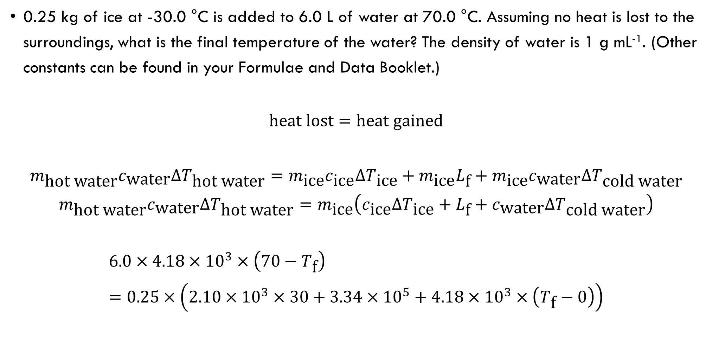
Example 3
0.25 kg of ice at -30.0 °C is added to 6.0 L of water at 70.0 °C. Assuming no heat is lost to the surroundings, what is the final temperature of the water? The density of water is 1 g mL⁻¹. (Other constants can be found in your Formulae and Data Booklet.)
$$\text{heat} \text{lost}=\text{heat} \text{gained}$$
$$m_{\text{hot} \text{water}}c_{\text{water}}ΔT_{\text{hot} \text{water}}=m_{\text{ice}}c_{\text{ice}}ΔT_{\text{ice}}+m_{\text{ice}}L_{\text{f}}+m_{\text{ice}}c_{\text{water}}ΔT_{\text{cold} \text{water}}$$
$$m_{\text{hot} \text{water}}c_{\text{water}}ΔT_{\text{hot} \text{water}}=m_{\text{ice}}\left(c_{\text{ice}}ΔT_{\text{ice}}+L_{\text{f}}+c_{\text{water}}ΔT_{\text{cold} \text{water}}\right)$$
$$6.0×4.18×{10}^{3}×\left(70−T_{\text{f}}\right)=0.25×\left(2.10×{10}^{3}×30+3.34×{10}^{5}+4.18×{10}^{3}×\left(T_{\text{f}}−0\right)\right)$$
Notes:
Note that the question assures us that the final state of the mixture is liquid (“what is the final temperature of the water?”).

Slide 13

Example 3 cont.
$$6.0×4.18×{10}^{3}×\left(70−T_{\text{f}}\right)=0.25×\left(2.10×{10}^{3}×30+3.34×{10}^{5}+4.18×{10}^{3}×\left(T_{\text{f}}−0\right)\right)$$
$$1755600−25080 T_{\text{f}}=15750+83500+1045 T_{\text{f}}$$
$$1656350=26125 T_{\text{f}}$$
$$T_{\text{f}}=\frac{1656350}{26125}=63.4 °\text{C}$$
Notes:
Note that the question assures us that the final state of the mixture is liquid (“what is the final temperature of the water?”).

